Slide 1
Are you evaluating a genomics education intervention?
One of the challenges to ensuring effective genomics education is the lack of needs assessments and evaluation of education interventions. We developed this evaluation framework¹ and companion tool to address this challenge.
Some key questions you might consider when conducting an evaluation:
(adapted from Smart, J. (2020) Planning an evaluation: STEP BY STEP. The Australian Institute of Family Studies. https://aifs.gov.au/sites/default/files/publication-documents/2006_planning_and_evaluation_step_by_step_0.pdf)
This genomics education evaluation tool is based on two research publications^{1,2} and has been developed to help you identify what you will measure and how you can measure it. It may also help you to work out who to collect data from and how long it can take.
It includes:
A description of an evaluation framework¹ and its components
Common concepts and measures that are used for needs assessments and evaluation of genomics education interventions. These are arranged in categories or stages according to the evaluation framework. You can choose which stages, concepts or measures you might like to explore.
The tool links to a spreadsheet with more information:
Research questions and metrics reported in published needs assessments and genomics education evaluations (2000-2023)² and references.
Reusable stems for commonly-asked questions
1. Why do I need to evaluate? (Purpose, audience) | 2. What do I need to find out? (Evaluation question, design) | 3. What will I measure? (Outcomes, outputs, indicators)
4. How will I measure it? (Methods, quality) | 5. Who will I collect data from? (Sample, ethics) | 6. How long will this take? (Timeline) | 7. What do I do with the data? (Analysis, write-up, dissemination)
Nisselle A, Terrill B, Janinski M, Metcalfe S, Caff C. Ensuring best practice in genomics education: A theory- and empirically-informed evaluation framework. Am J Hum Genet (under review)
Nisselle A,* Terrill B,* Janinski M, Martyn M, Terrill B, Kaunein N, Jordan H, Metcalfe S, Caff C. Ensuring best practice in genomics education: A scoping review of genomics education needs assessments and evaluations. Am J Hum Genet (under review)
Notes:
The tool is designed as a template and menu of possible concepts or measures.
You can print the pages out to discuss which measures you might use and cross out the ones you won’t.
There are spaces for you to summarise your approach and to add your own concepts for/from discussions with stakeholders.

Slide 2
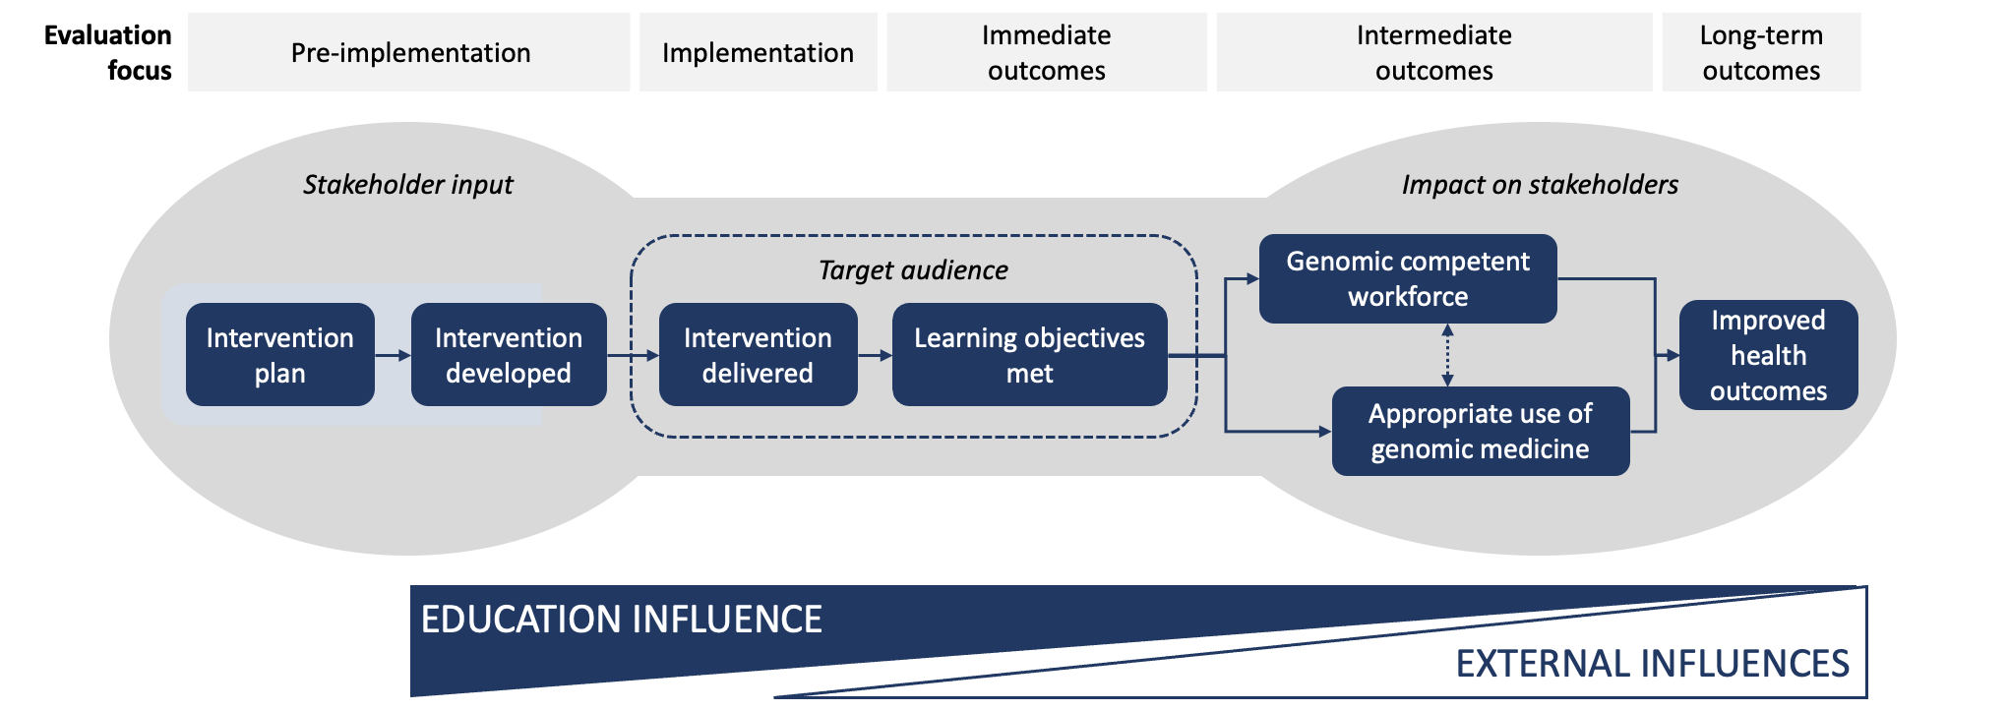
An evaluation framework for genomics education interventions
From: Nisselle A, Terrill B, Janinski M, Metcalfe S, Caff C. Ensuring best practice in genomics education: A theory- and empirically-informed evaluation framework. Am J Hum Genet (under review)
Find a video description of the model [coming soon]
Notes:
In this model, the gray background reflects the range of possible stakeholders involved at each stage.
They might be providing input, participating in the education and/or people impacted by the education intervention.
The dark blue boxes represent what is achieved at each stage of implementation.
The white and blue triangles reflect different influences on outcomes. ---------------------
Evaluation should inform planning of an intervention. Needs assessments can confirm a local need and identify target audiences, topic areas, and modalities of an intervention.
Evaluation can provide information to improve or remediate pilot interventions. Details of the pilot delivery and actual participants (which may differ from target) can suggest improvements.
Evaluation of outcomes such as change in knowledge, perceived attitudes and confidence can provide information about the immediate impact of an intervention. Intent to behave in a particular way post intervention and knowing how to apply a genomic theory or skill in response to a scenario (procedural knowledge) may also be immediate outcomes.
Evaluation of whether learnings are applied in practice and applied genomic competence after an intervention are intermediate outcomes. Intermediate outcomes can be measured at the level of the individual, group or institution.
This evaluation framework focuses on genomics education interventions, which ultimately aim to improve health through appropriate use of genomic medicine by a competent workforce. Therefore long-term aims relate to improved health outcomes and behaviours.

Slide 3
Some considerations for genomic evaluation
Consider what your project could achieve from planning and delivery to short- and long-term outcomes.
Evaluation should inform planning of an intervention. Needs assessments can confirm a local need and identify target audiences, topic areas, and modalities of an intervention.
Evaluation can provide information to improve interventions. How the intervention was delivered (implementation) such as attendance or use, and actual participants (which may differ from the target audience), can suggest improvements.
Evaluation of outcomes such as change in knowledge, attitudes and confidence can provide information about an intervention’s immediate impact. Immediate outcomes could include intent to behave in a particular way post-intervention or knowing how to apply a genomic theory or skill in response to a scenario (procedural knowledge).
Evaluation of whether, and how, learnings are applied in practice, and applied genomic competence after an intervention, are intermediate outcomes. Intermediate outcomes can be measured at the level of the individual, group or institution.
Genomics education interventions ultimately aim to improve health through appropriate use of genomic medicine by a competent workforce. Therefore, long-term outcomes relate to improved health and behaviours.
Consider the relationships between, and influences on, outcomes
Is there useful implementation evaluation data that could be used to help to explain immediate, intermediate and long-term outcomes? Are there external influences that you could measure, or need to account for in these outcomes?
Consider the range of stakeholders who could influence your outcomes
The breadth of stakeholders will vary across the stages of planning, delivery and outcome evaluation. Have you considered evaluating effects on all stakeholders (from the target audience to their colleagues and patients/families of patients)?
Consider how the concepts you measure align with the theory that underpins your intervention
Take care with concepts and language. For example, are you measuring: ‘confidence’ or ‘comfort’; ‘knowledge’ or ‘literacy’; ‘applying principles or skills’ or ‘knowing how to apply principles or skills’?
Consider the timing of your data collection
Evaluation outcomes can be evaluated at any point in time after an intervention is delivered. However, the terms used in this evaluation framework indicate the focus of the evaluation, not the timing of data collection activities. For example:
change in knowledge – and whether it is maintained over time – is always considered an immediate outcome, irrespective of whether data is collected immediately after an intervention, or months or even years later.
intermediate outcomes around competency and appropriate use of genomic medicine, and long-term outcomes around improved health, may be evaluated at any point after an intervention is delivered.
The term ‘long-term follow-up’ can be used to denote evaluation conducted several months or years after an intervention. However, if the evaluation only collects data on immediate and/or intermediate outcomes, then it would not be considered ‘long-term’ in this framework.
Recommendations adapted from Nisselle A, Terrill B, Janinski M, Metcalfe S, Caff C. Ensuring best practice in genomics education: A theory- and empirically-informed evaluation framework. Am J Hum Genet (under review)
Notes:
Recommendations adapted from Nisselle A, Terrill B, Janinski M, Metcalfe S, Caff C. Ensuring best practice in genomics education: A theory- and empirically-informed evaluation framework. Am J Hum Genet (under review)

Slide 4
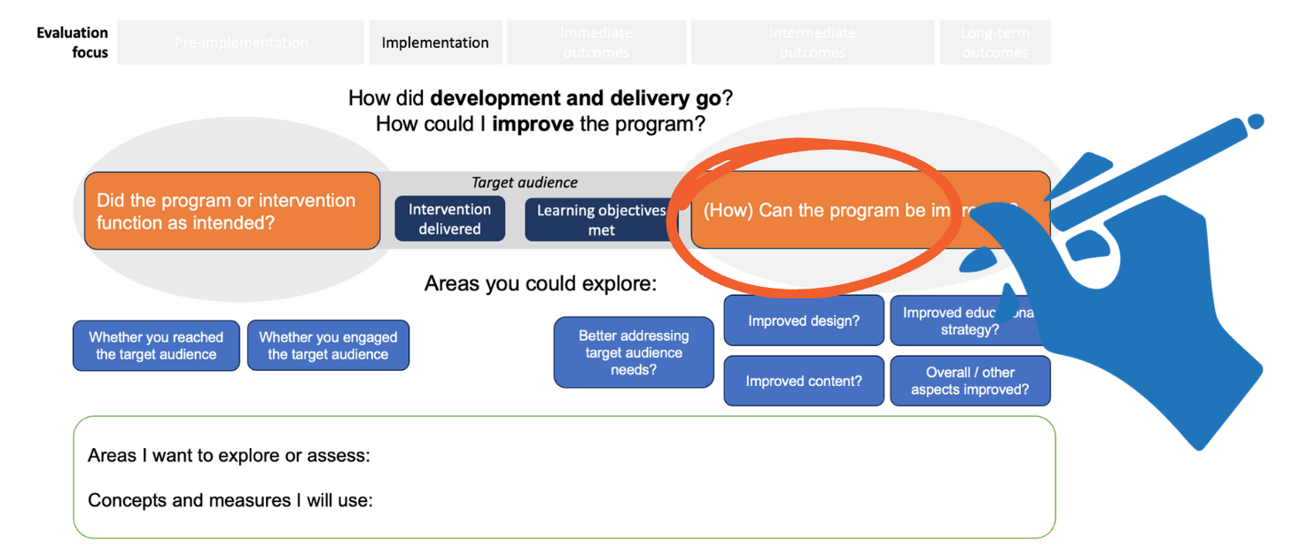
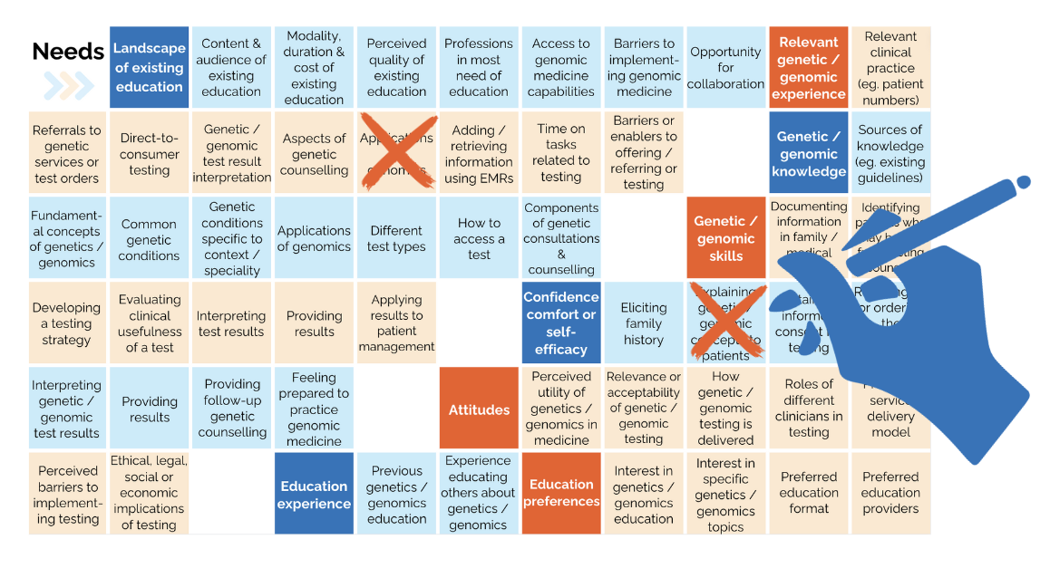
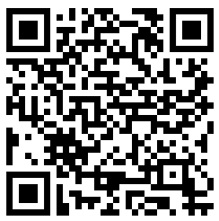
You can interact with the tool at multiple levels:
learn more about the framework;
consider concepts for your own evaluation;
choose measures for your own evaluation;
refer to published questions for your project.
Using the evaluation tool
You can use these tools as part of a conversation about concepts and measures to include in (and exclude from) your evaluation.
Each pair of tool templates focus on a single stage or section of the evaluation framework.
For each stage or section there is:
A template introducing possible concepts to explore in an evaluation with a box to record your areas of interest for your evaluation
A ‘bingo card’ of potential metrics you can choose to include, exclude, add to or replace.
The concepts we include here are a selection and do not cover all possibilities.
Blank boxes are included for you to add or replace concepts or measures, particularly if you are using the framework in projects other than health genomics education.
The templates can be printed back-to-back in colour or black and white.
Alternatively, you might want to copy the components to an online whiteboard and populate them with stickies/online post-its.
Framework stage template
Measures bingo card
https://www.australiangenomics.org.au/categories/workforce-education/
Notes:
Templates and tools are available from https://www.australiangenomics.org.au/categories/workforce-education/
Contact education@australiangenomics.org.au

Slide 5
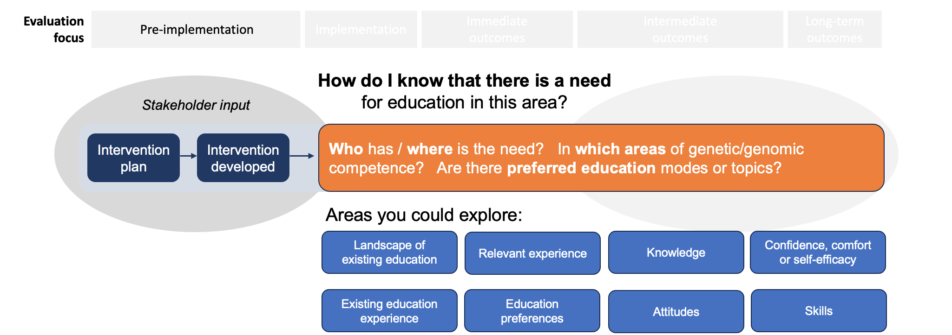
Areas I want to explore or assess:
Concepts and measures I will use:
Notes:
If there is no current evidence on the genetic / genomic education needs of your learners, and time and resources permit, you could conduct a needs assessment.
Needs assessments can identify whether there is a need for education and can access relevant stakeholder views to guide your genomics education intervention.
A needs assessment can help to answer questions like:
Where is the need: in which profession, context or region? The need is in which areas of genetic/genomic competence?
Which topics or modes of education delivery do people currently use or invest in?
Which topics or modes of education delivery are preferred?
Some areas that people have explored in needs assessments include:
Landscape of existing education
Experience relevant to genetic/genomic testing
Knowledge of genetic/genomic testing
Skills in genetics/genomics
Attitudes to aspects of genetics/genomics
Confidence or comfort with genetics/genomics
Genetics/genomics education experience or preferences

Slide 6
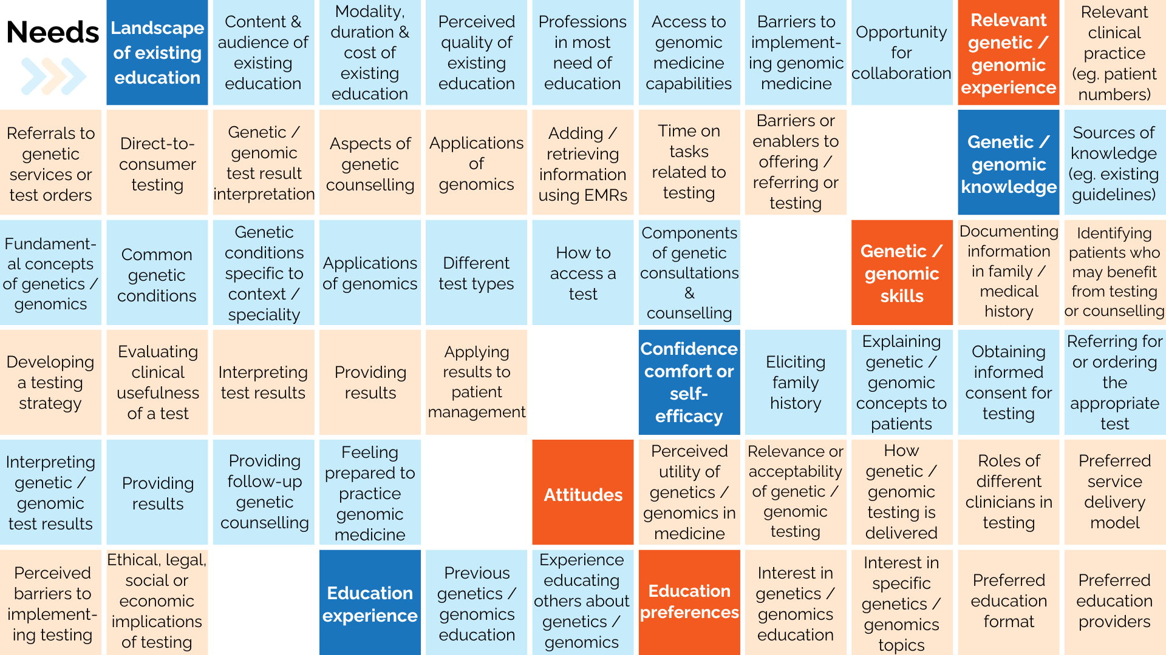
Notes:
Templates and tools are available from https://www.australiangenomics.org.au/categories/workforce-education/
Contact education@australiangenomics.org.au

Slide 7
Areas I want to explore or assess:
Concepts and measures I will use:
Notes:
Implementation spans the development and delivery stages of an education program.
Evaluation at this stage is more operational.
Some areas people have explored include:
Was the audience reached? Was the audience engaged?
Can the program be improved by …
Better addressing target audience needs?
Educational strategy?
Design?
Content?
Other factors?

Slide 8
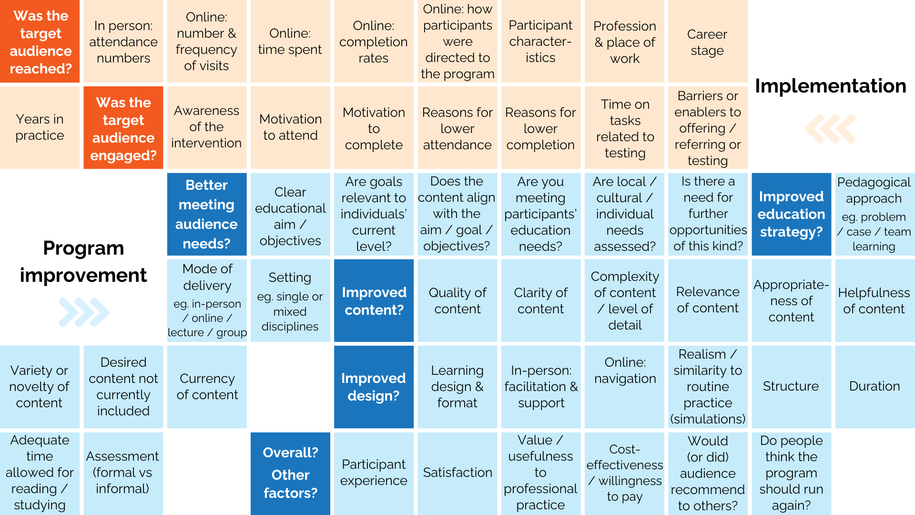
Notes:
Templates and tools are available from https://www.australiangenomics.org.au/categories/workforce-education/
Contact education@australiangenomics.org.au

Slide 9
Areas I want to explore or assess:
Concepts and measures I will use:
Notes:
Evaluation of the immediate outcomes of a genomics education intervention focuses on the program’s immediate impact.
Immediate outcomes may include change in knowledge (including knowing how to apply knowledge or a skill), perceived attitudes and confidence.
Immediate doesn’t always refer to ‘immediately after the intervention’:
Within immediate impact, you can assess if genomic knowledge, skills, attitudes and confidence have been gained, retained over time and/or gained in comparison with a control group (not getting the intervention, having the intervention later, or having a different intervention).
Question/scales for immediate outcomes are highly variable
Questions/tasks used to assess participants’ knowledge, skills, attitudes and confidence can be highly variable, depending on the audience, context and the emphasis of the study. Participants can be asked to rate or report on their own level of knowledge or capability rather than be assessed.
Immediate ‘skills’ developed are often ‘knowledge of how to do something’
‘Skills’ are included here as immediate outcomes if you are considering how to perform a genomics-related activity in a simulated environment or in response to a scenario. In this case, you are evaluating knowledge of how to apply a genomic theory or skill, which could be called procedural knowledge.
Skills can be assessed through
offline/online case-based scenarios relevant to the learning outcomes;
interpreting a sample genetic/genomic test report
in-person case-based scenarios, observational checklists, or expert coding of transcripts
in-person consultation observation
**If you are evaluating a skill ‘in practice’ then please proceed to Intermediate outcomes.

Slide 10
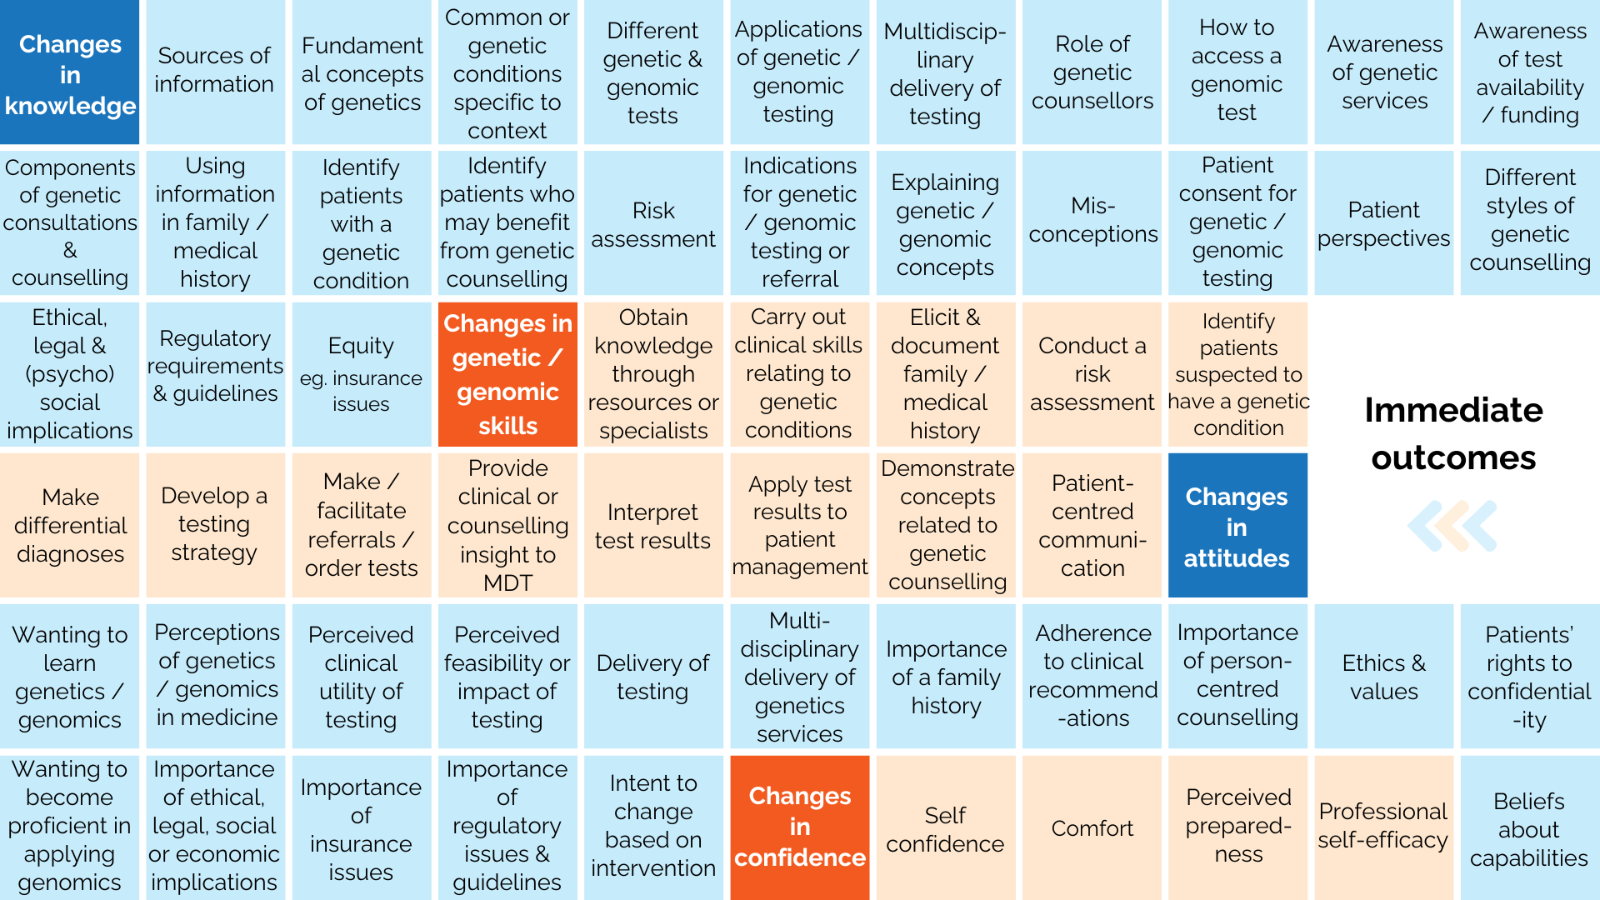
Notes:
Templates and tools are available from https://www.australiangenomics.org.au/categories/workforce-education/
Contact education@australiangenomics.org.au

Slide 11
Areas I want to explore or assess:
Concepts and measures I will use:
Notes:
Evaluation of the intermediate outcomes of a genomics education intervention focuses on whether, or how, learnings are applied in practice.
These tests of genomic competency can be a precursor to appropriate use of genomic medicine.
Intermediate outcomes may be evaluated at any time after the intervention, even several months later. They may be at an individual or at an organisational level, where participants in an education intervention may share knowledge and resources to effect change beyond their individual practice.

Slide 12
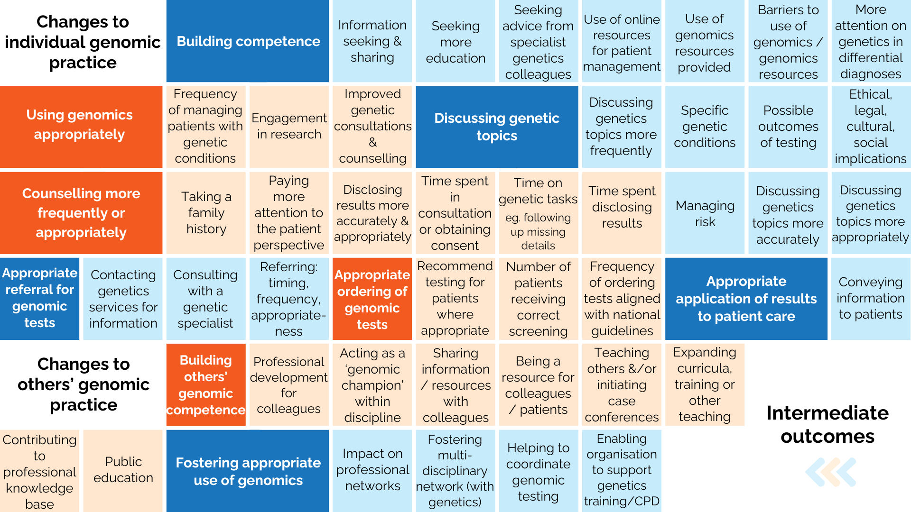
Notes:
Templates and tools are available from https://www.australiangenomics.org.au/categories/workforce-education/
Contact education@australiangenomics.org.au

Slide 13
Areas to explore:
Concepts and measures:
Notes:
In evaluation of genomics education for health professionals, we have defined long-term outcomes as improved health outcomes.
Health outcomes can be measured through audits or self-reported knowledge, attitudes, and behaviours of patients and their families. Some studies that look at long term outcomes audit appropriate patient behaviour (as determined by qualified researchers).
Questions:
Were there
changes in activities, behaviour, or attributes of patients or their families
following changes in practice of health professionals
who completed an education intervention?

Slide 14
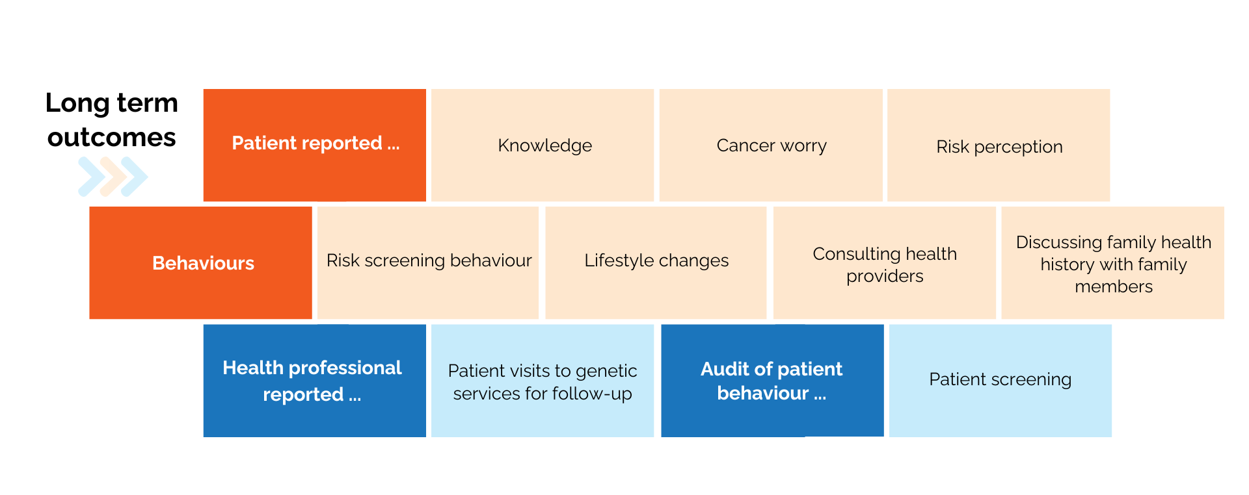
Notes:
Templates and tools are available from https://www.australiangenomics.org.au/categories/workforce-education/
Contact education@australiangenomics.org.au

Slide 15
Notes:
Are there external influences that you could measure or need to account for in these outcomes?
Immediate
Confidence in performing risk assessment compared (with control group)
Intermediate
Self-reported perceptions of work environment
· Organisational attitudes to incorporating genetics
· Working across disciplines
· Barriers and facilitators
Self-reported barriers and facilitators to personal practice
· Perceived acceptability, benefits and role
· Social influences
· Implementing family health history taking
· Workload
Long-term
Demographics of patients (age, gender, risk category)

Slide 16
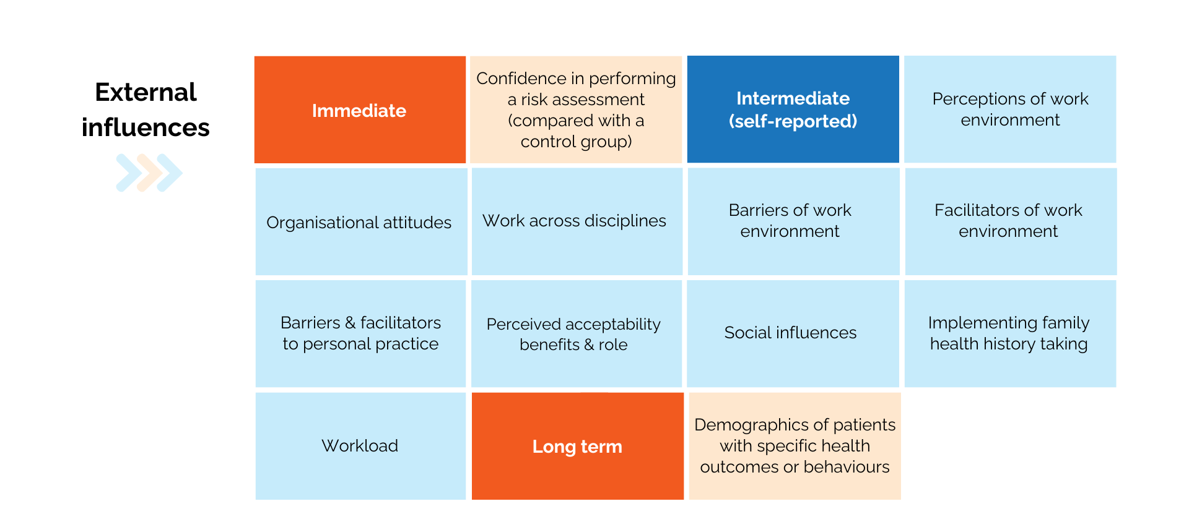
Notes:
Templates and tools are available from https://www.australiangenomics.org.au/categories/workforce-education/
Contact education@australiangenomics.org.au

Slide 17
Additional templates
Add your own concepts and measures.

Slide 18
Enter your concept here
Enter your concept here
Enter your concept here
Enter your concept here
Enter your concept here
Enter your concept here
Enter your concept here
Enter your concept here
Enter your concept here
Enter your concept here
Enter your concept here
Enter your concept here
Enter your concept here
Enter your concept here
Enter your concept here
Enter your concept here
Enter your concept here
Enter your concept here
Notes:
Templates and tools are available from https://www.australiangenomics.org.au/categories/workforce-education/
Contact education@australiangenomics.org.au

Slide 19
ADD CONCEPT HERE …
Add measure here …
Add additional text boxes as needed

Slide 20
Some concepts and questions you could include in an evaluation of a genomics education intervention
Question starters and examples of questions* that other studies have used can be found in the online spreadsheet at: https://docs.google.com/spreadsheets/d/1CuMi6lQ3dBZjkmsVXBfx9IrHh5Wq_WtrSatjuNrLNPw/edit?usp=sharing
*Questions and measures were sourced from a literature review of publications up to June 2023. Each of the measures can be linked back to the original reference. References have also been included in the last sheet of the online spreadsheet.
Notes:
References will be linked to the supplementary table of Nisselle, Terrill et al. (manuscript under review) but have also been included in the last sheet of the online spreadsheet.

